Slide 1
ICM ConOps & Budgets Update
Sample Transfer & Handling System
Joseph Bowkett
2023-12-06
MSR-SRL-STS In-Contact Manipulation

Slide 2
Contents: ICM ConOps & Budgets Update
Joel Model Progress
Preston Model Progress
Budget Status (w.r.t. updated models)
Asimov C6 Agile Initial Results
Model Validation Plan thru TTR (Q2 FY24)
Updated Peg-in-Hole ConOps
Summary

Slide 3
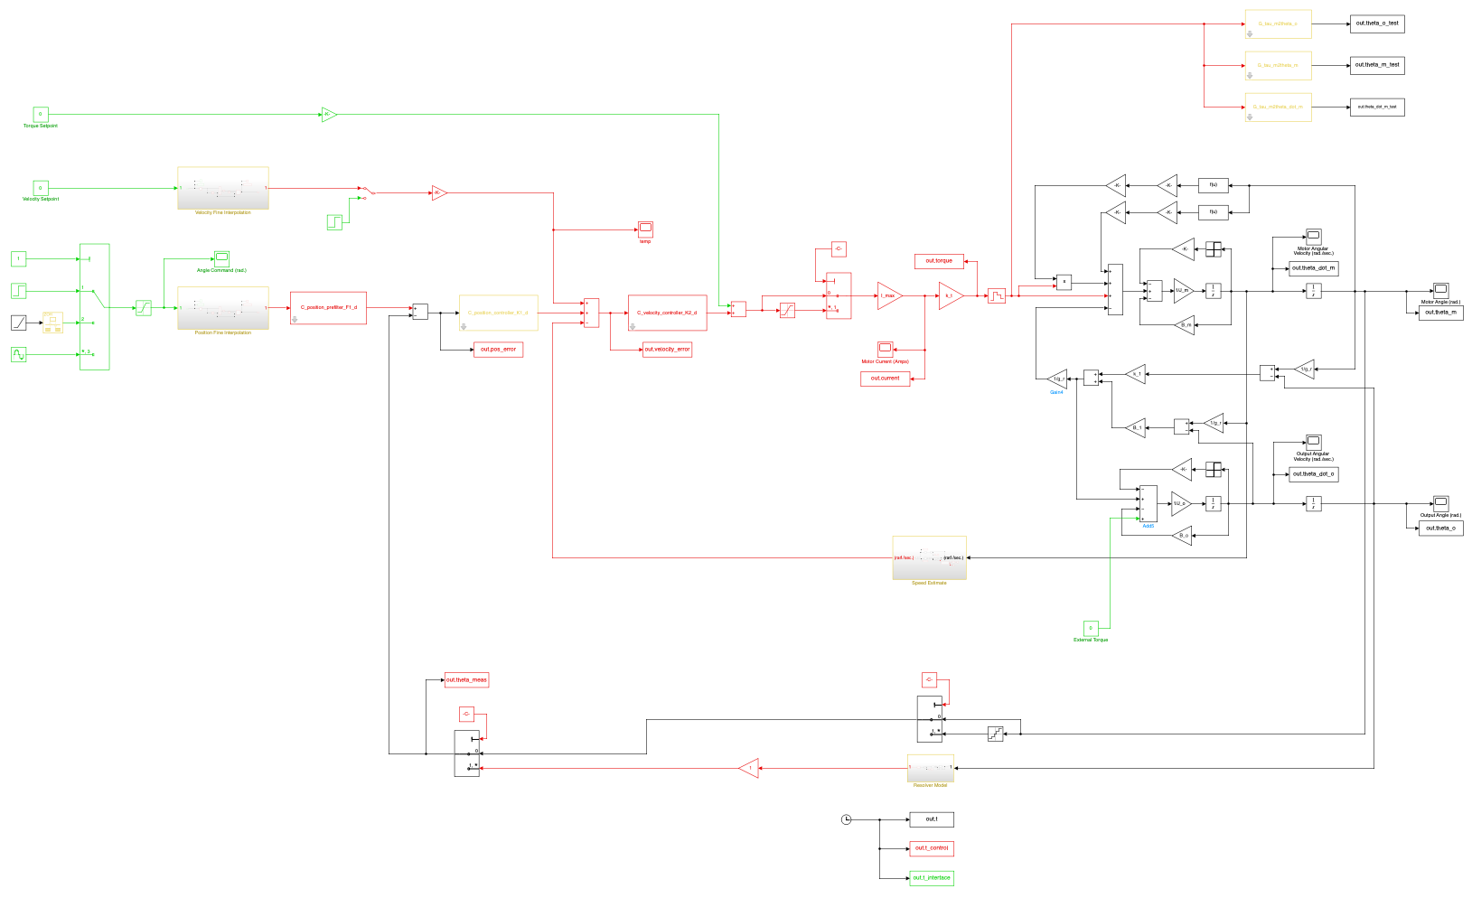
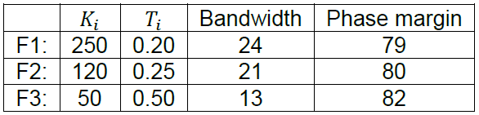
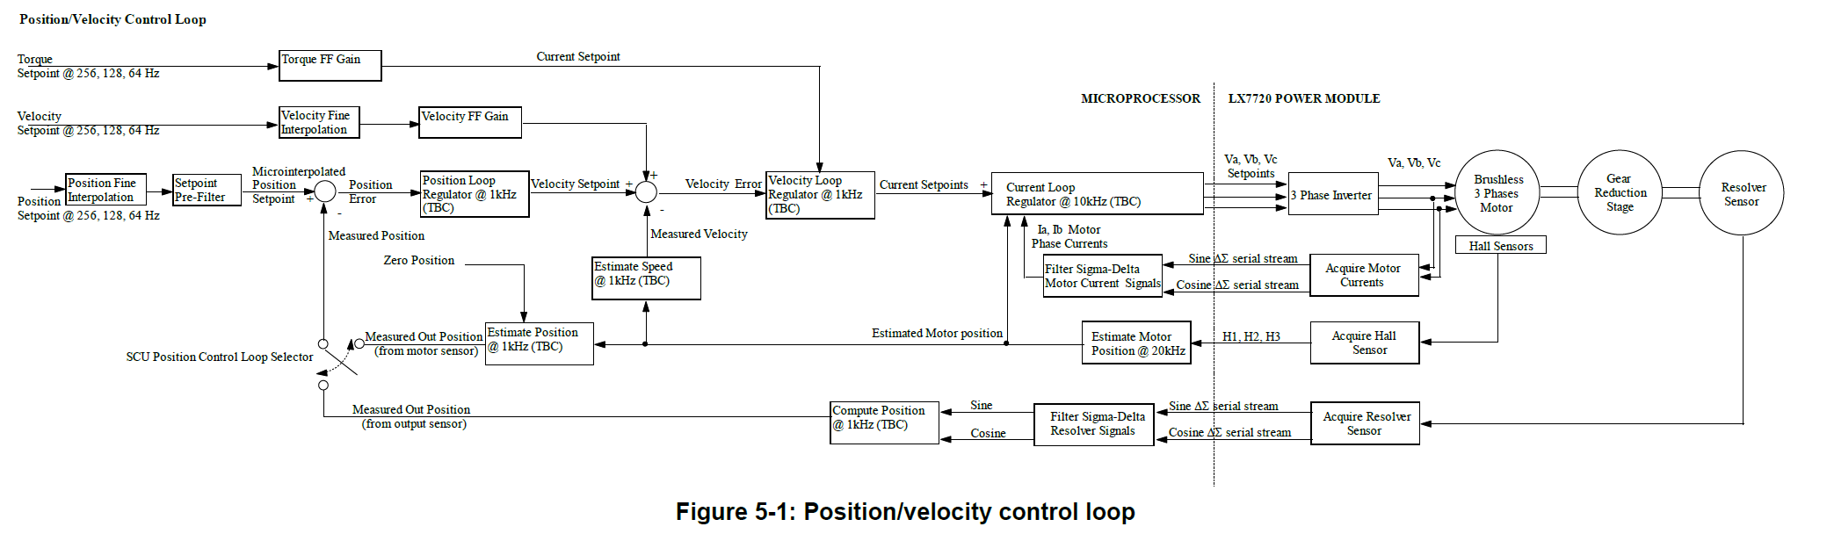
Joel Model Progress
JPL’s updated “actuator model” recently delivered by 3434 analyst.
Both Simulink and Transfer Function match the LDO quoted performance for same gain selection. LDO velocity loop gains and stability:
Joel Shields (3434) Actuator Model
This is a first draft of our “truth” model of actuator performance, now being refined against dev testbeds and soon IFSM.
LDO Actuator Model

Slide 4
Joel Model Progress
Next steps:
This model has already been used to update the force and stability budgets for RGA-OS, now being rolled out to other subfunctions (making a MATLAB for loop go beyond index=1)
Joel is now refining this model against Clark and will do same for IFSM once that arrives. Will compare this against LDO model if they ever deliver it.
State parameter sensitivities with LTI model.
This is the model used for FM LTI stability DP closure.
JPL’s updated “actuator model” recently delivered by 3434 analyst.
Both Simulink and Transfer Function match the LDO quoted performance for same gain selection. LDO velocity loop gains and stability:
This is both the underpinning model of the full system, but also used for “disembodied actuator” test comparison against Clark.
This is a first draft of our “truth” model of actuator performance, now being refined against dev testbeds and soon IFSM.
LDO Actuator Model

Slide 5
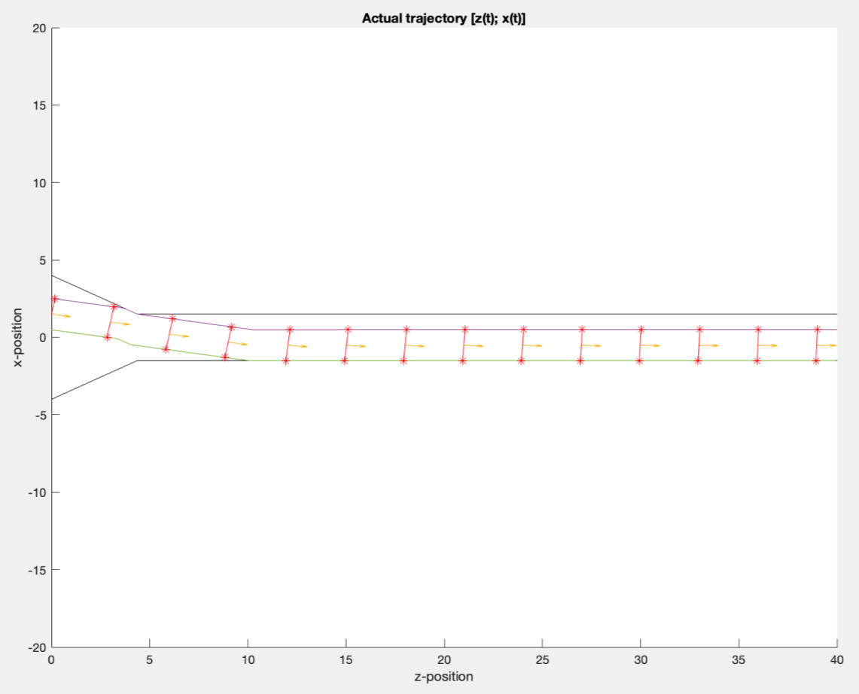
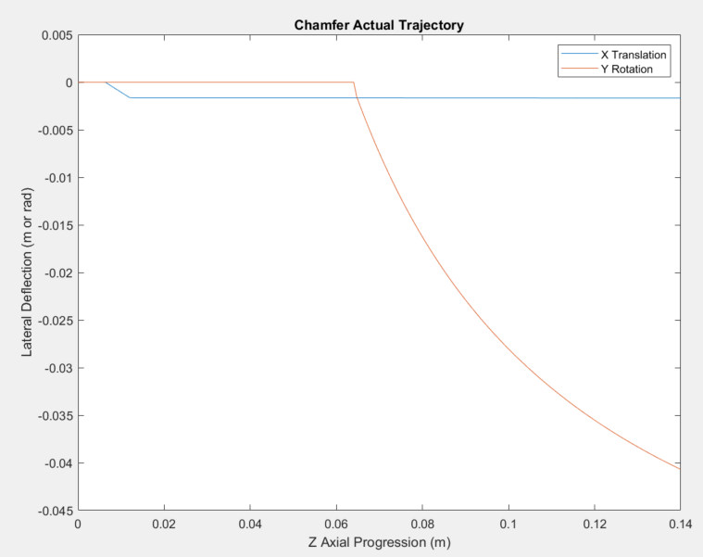
Preston Model Progress
Current status:
Delivered collision-based simulation of true peg-in-hole “geometric deflection profile”, which improves on the rough ramp profile used thus far
Gradient values from this model used to update the RGA-OS subfunction AC excitation rates
This model provides the “disembodied tool” response, where we show the resultant force profile for some tool-station interaction if the arm and actuators were perfect
Next steps:
Compare this model’s force profile predictions against Asimov C6 on RGA-OS and TGA-Glove interactions
Expand RGA-OS subfunction LTI budgets analysis across all subfunctions
Integrate tool-station profile model with actuator model for the “non-linear” simulation of peak forces, compare to LTI analytical values
Note, this contains no notion of compliance, boundary conditions, or force
Plot of “peg” orientation and corner points during any form of insertion operation. Geometric only, force response applied on top of this, not to scale. Fully general and parameterized.
“Actual deflection” of tool relative to baseline trajectory. This is what feeds into the force profile prediction.
May present on this next week

Slide 6
Current Budget Status: RGA-OS Insertion Sleeve 7
Green = improvements
Present RGA-OS insertion budgets are evaluated against a) present notional gains, b) latest LDO actuator model from 3434 analyst, and c) 2nd order active compliance (up from 1st)
Parameters:
Baseline insertion speed: 1.2mm/s
Translational misalignment: 3.5mm
Rotational misalignment: 69 mrad (down from 87)
Control rate: 64Hz/128Hz (down from 256)
Control delay cycles: 6
Insertion motion duration: 2 minutes
Axis | Operational Budget | Present Model Max | Gain Margin | Phase Margin
Force X | 15N | 5.46N (64% margin) | 22.4dB | 66.3 deg
Force Y | 15N | 5.43N (63% margin) | 23.2dB | 68.7 deg
Torque X | 2.25Nm | 1.03Nm (54% margin) | 21.3dB | 61.7 deg
Torque Y | 2.25Nm | 1.03Nm (54% margin) | 21.2dB | 61.4 deg
Key takeaways:
All axes meet operational force budgets with >50% margin
All axes meet JPL Design Principles for phase and gain margin
JPL DP Stability Margins | Gain | Phase
Standard | 10 dB | 60 deg
“High performance” | 6 dB | 30 deg
Notes:
Note that 64Hz with 6RTI delay met stability margins at exactly this pose.

Slide 7
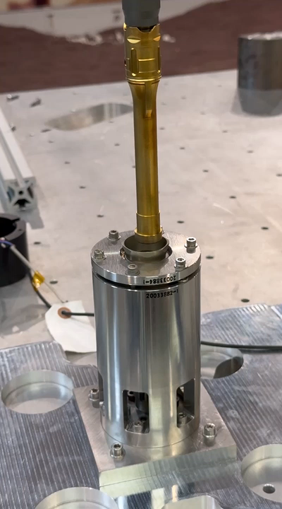
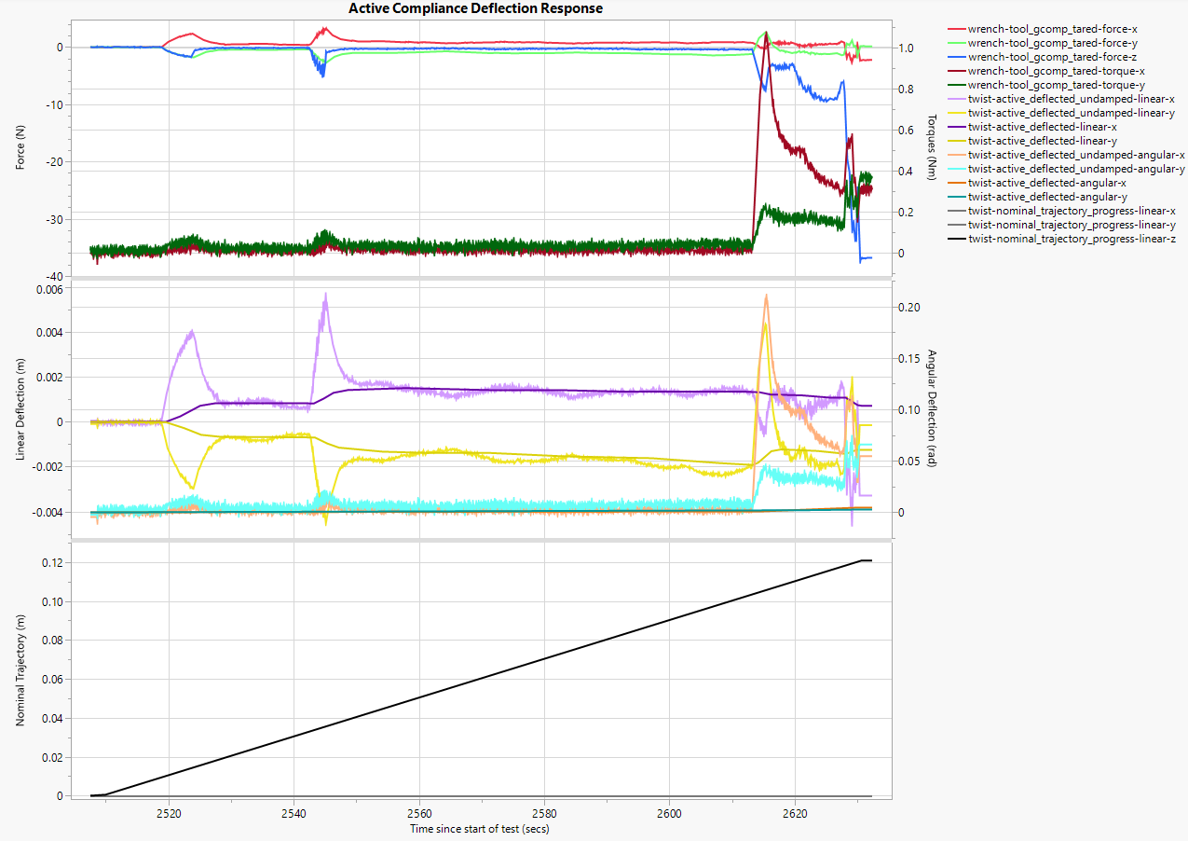
Asimov C6 Agile Initial Results
ASIMOV475:
Credit to Sihah Joonhigh, Danny Green, and Kris Wehage
1st chamfer contact
2nd chamfer contact
Pawl contact
Force fault Fz=35N
Undamped Response
Both TGA -> Glove and also RGA -> OS Sleeve worked perfectly first time on EDU hardware.
Models predicted the wrench magnitudes well.
Test outcomes:
Misalignment: ~3mm, ~0.017 mrad
Peak force: 5.3N (predicted 5.5N)
Peak moment: 0.15Nm (predicted 0.33Nm)
Damped Response
As expected, pawl activation incurs much higher forces, as also experienced by Bit Shuttle testing. Needs more exploration in Asimov C6 proper.

Slide 8
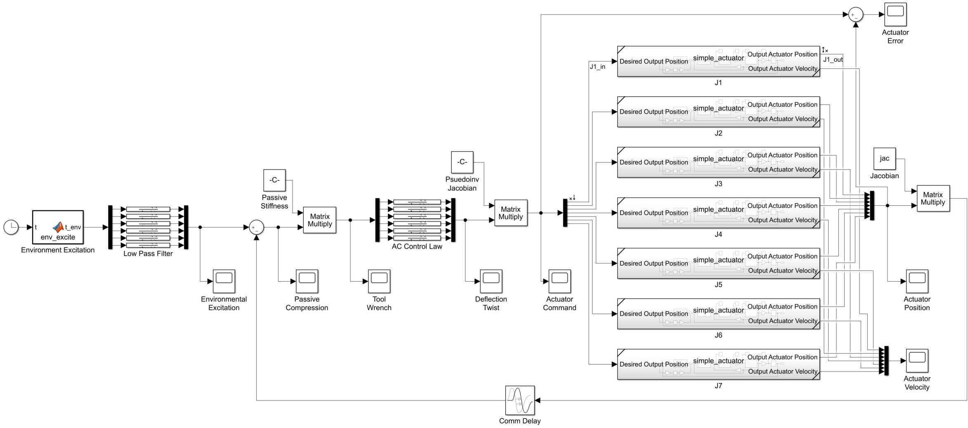
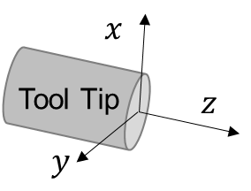
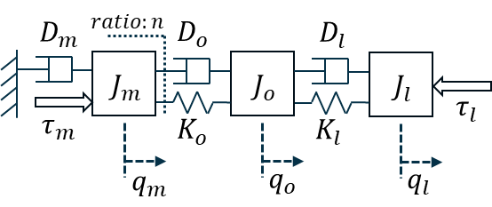
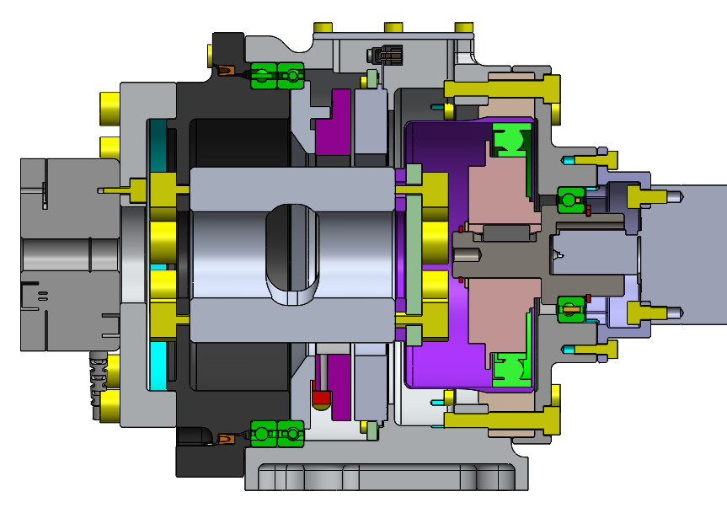
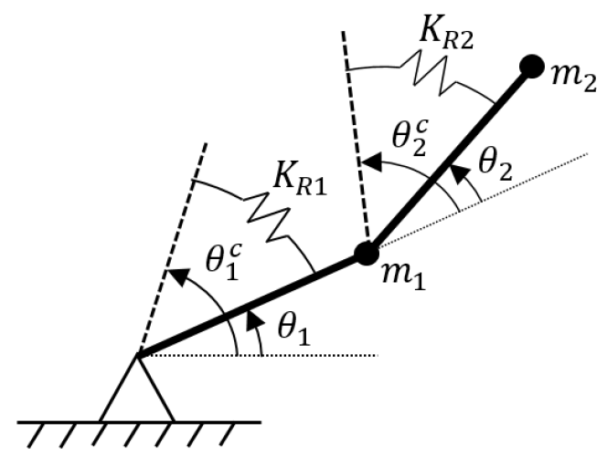
Model Validation Plan thru TTR
MSR-SRL-STS In-Contact Manipulation
Immediately jump to end-to-end demo for each station
Bradbury C1+
Asimov C6
7 “parallelized” actuators
Disembodied tool
FM Budget, Stability, Sensitivities
Single DoF AC and FR
Clark C3
Disembodied actuator
Clark C2
(if needed) Full non-linear arm dynamics model
Now
Time
TTR

Slide 9
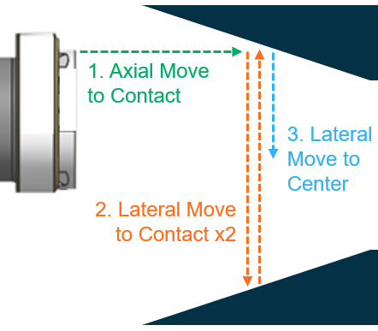
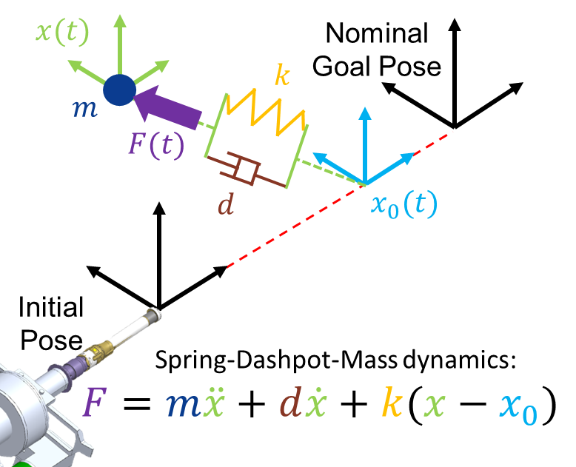
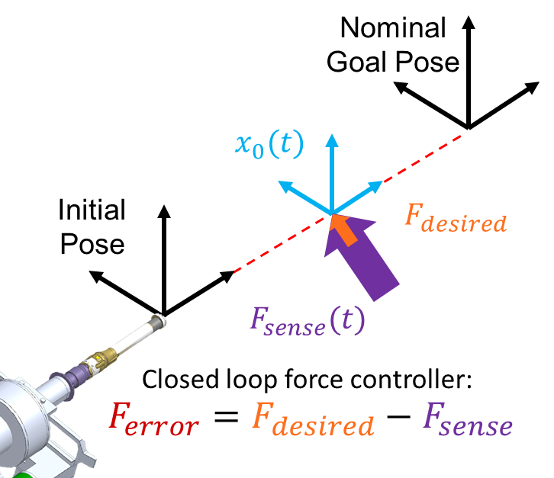
Updated Peg-in-Hole ConOps
MSR-SRL-STS In-Contact Manipulation
1. Chamfer Find:
Free space standoff -> Free space centered
2. Active Compliance:
Free space centered -> Past high load region
3. Force Regulation:
Stationary lateral force null to straighten RGA in sleeve
4. Force Regulation:
Plan baseline along newly straightened tool frame, null lateral
Benefits: - Mitigates “Jacobian Staleness”
- Reduces OS sleeve pawl activation loads
Proprioceptive centering to remove most translational misalignment
(or score a hole in one)
Behave like an RCCM to do “peg in hole” misalignment correction
Null side loads to straighten, then finish insertion while nulling
Notes:
Relevant comment, step 2 could actually be done with “Force Regulation” just as easily as Active Compliance, which would eliminate one of our two control modes and simplify to just “Force Regulation”, which is really just heritage enforced deflection done slightly faster

Slide 10
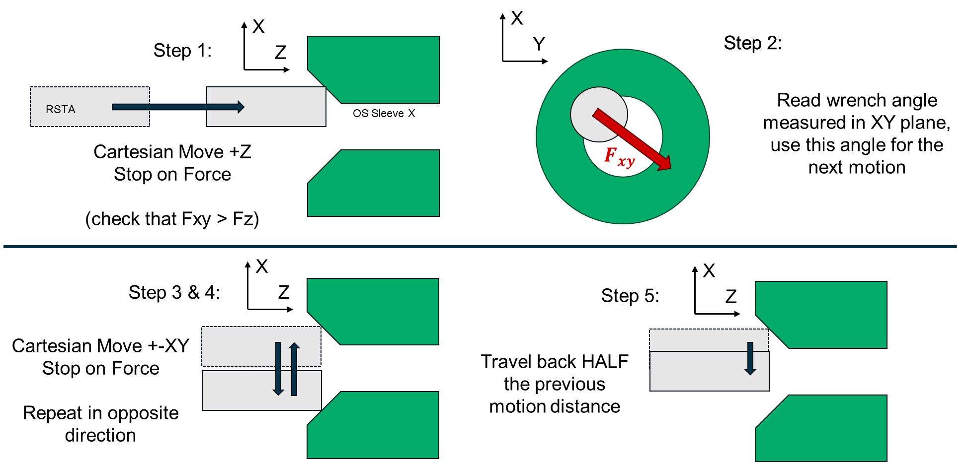
Updated Peg-in-Hole ConOps: New Behavior: Chamfer Find
MSR-SRL-STS In-Contact Manipulation
1. Chamfer Find:
Free space standoff -> Free space centered
New recommended “Chamfer Find” behavior uses negligible new FSW, essentially just 4 “Move to Contact” motions, then re-tare FTS.
Eliminates: Jacobian staleness concern, most translational misalignment (brings down peak forces), reduces time since FTS tare and therefore drift
Joseph Carsten has already proposed an operational approach, only requires one new FSW snippet to point a frame toward force in XY plane
Proprioceptive centering to remove most translational misalignment
(or score a hole in one)

Slide 11
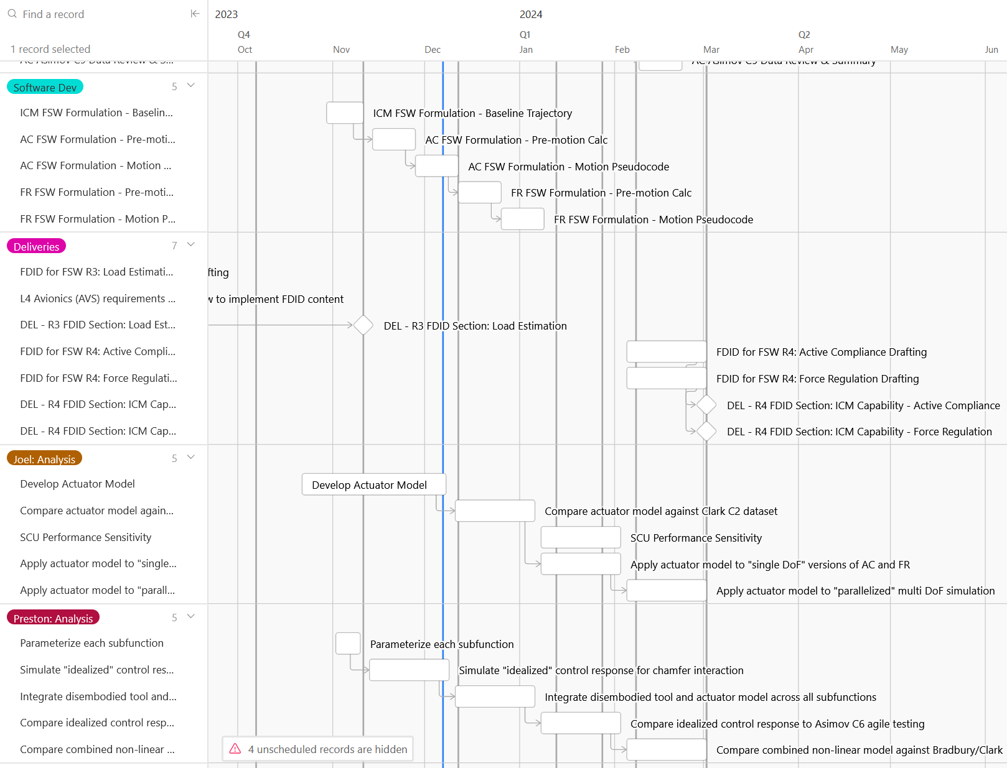
High Level Summary
Present Schedule (testbed campaigns off screen)
Joel and Preston’s model development is now moving along nicely
Updated budgets show >50% force margin and improved stability margin
We’re now confident on the 128Hz control rate, which was considered borderline at PDR (hence 256Hz being requested)
Reducing further to 64Hz is also now looking feasible, though need to apply studies to full array of peg-in-hole locations to be sure
Model development and validation plan on track for Q2 TTR next year
Near term concern: testbed software support
Proposed TTR
Now

Slide 12
Backup
MSR-SRL-STS In-Contact Manipulation

Slide 13

Operational Solution: New Capability: Chamfer Find
MSR-SRL-STS In-Contact Manipulation
X
X
Step 2:
Step 1:
Z
Y
Step 2:
Read wrench angle measured in XY plane, use this angle for the next motion
RSTA
OS Sleeve X
Cartesian Move +Z
Stop on Force
(check that Fxy > Fz)
$$F_{xy}$$
X
X
Step 3 & 4:
Z
Step 5:
Z
Cartesian Move +-XY
Stop on Force
Repeat in opposite direction
Travel back HALF the previous motion distance

Slide 14
Joseph C’s take on how to do this *mostly* operationally
ARM_SET_TARGET 0 0 0 0 0 0 VIS_LOCALIZED ABS #Set the arm target to the vision localized pose.
ARM_MOVE_CART_LINEAR TIP_INT 0 0 0.02 0 0 0 ARM_TARGET ABS 0 REL GUARDED 1.0 #Move into intial contact.
SEQ_IF FORCE_XYZ GT 4 #Check if we've made contact. If not this is a hole-in-one!
SEQ_IF FORCE_XY LT 2 #See the side loads are sufficient. If not then assume we missed the chamfer.
ARM_MOVE_CART_LINEAR TIP_INT 0 0 -0.1 0 0 0 ARM_TARGET ABS 0 REL RETRACTING 1.0 #Backoff into free space
ACM_PRECLUDE_ACTIVITY PRECLUDE ARM TRUE
SEQ_ENDIF
ARM_SET_TARGET_FORCE_MEAS 0 0 0 0 0 0 TIP_INT ABS_POS_ONLY #Set the position of the arm target to the tube tip, accounting for deflections induced by external loading. Don't change the orientation of the original vision localized target.
ARM_ALIGN_TARGET_WITH_FORCE XY #Rotate about the target frame Z axis until the X axis aligned with the projection of the force vector onto the target frame XY plane.
ARM_MOVE_CART_LINEAR TIP_INT 0.03 0 0 0 0 0 ARM_TARGET ABS 0 REL CONTACT 1.0 #Move laterally in the direction of the external load to find the opposite side of the chamfer.
ARM_SET_TARGET_FORCE_MEAS 0 0 0 0 0 0 TIP_INT AVE_POS_ONLY #Average the position of the existing arm target with the current tube tip position to estimate the center of the chamfer.
SEQ_ENDIF
#Backoff into free space
ARM_MOVE_CART_LINEAR TIP_INT 0 0 -0.02 0 0 0 ABS 0 CONTROL_FRAME RETRACTING 1.0
#Line up with the new estimate of the chamfer center
ARM_MOVE_CART_LINEAR TIP_INT 0 0 -0.1 0 0 0 ARM_TARGET ABS 0 REL FREE_SPACE 1.0 #Backoff into free space
ARM_TARE_WRENCH
ARM_ACTIVE_COMPLIANCE...
I was thinking a little more about option 3 and how we might sequence something like that. On MSL and M2020 I've found the concept of the arm target frame to be a powerful and versatile tool. The arm target infrastructure was really just a family of commands that let the user manipulate a coordinate frame in various ways and then we could command the arm in that frame. Here perhaps we'd use a few heritage concepts plus a couple new ones.
Heritage:
-Basic ARM_SET_TARGET command. Lets the user set the arm target to an arbitrary offset from a specified base frame (when in ABS mode) or update just the position and leave the orientation untouched (when in ABS_POS_ONLY mode).
-ARM_SET_TARGET_FORCE_MEAS. Set the arm target relative to a specified kinematic control frame whose pose has been computed using the FTS measured loads as part of the deflection modeling.
New concepts:
-ARM_ALIGN_TARGET_WITH_FORCE command. Takes one argument specifying how to do the alignment. Updates the orientation of the arm target, leaving the position alone. In XY mode, rotates about the target frame Z axis until the X axis is aligned with the projection of the force vector onto the target frame XY plane. This is what we'd use to move in the desired lateral direction (which would be along target frame X) to find the other side of the chamfer. In XYZ mode, the target frame Z axis would point along the direction of the force vector (not sure the most sensible way of setting the twist about the Z axis as it would essentially be arbitrary).
-New AVE, AVE_POS_ONLY, and AVE_ORI_ONLY options to the target setting commands. These would average a specified frame with the current arm target frame to generate the new arm target. This is how we'd compute our centered target. AVE would average both position and orientation. AVE_POS_ONLY would only average the position and keep the original target orientation. AVE_ORI_ONLY would do the opposite.
Below is a rough straw man of what the commanding might look like

Slide 15
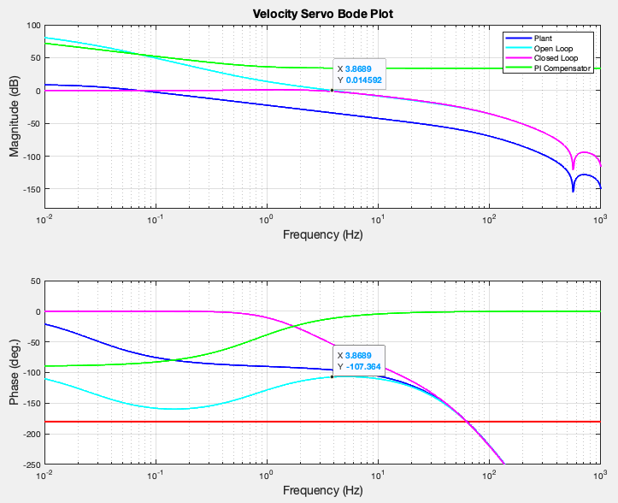
Joel Shields Actuator Model
JPL’s updated “actuator model” recently delivered by 3434 analyst.
Both Simulink and Transfer Function match the LDO quoted performance for same gain selection. LDO velocity loop gains and stability:
3.8689 rad/s = 24.03 Hz
Motor Family 1 Response
180-107 = 73 deg phase margin
Both bandwidth and phase margin match within 10% across the 3 motor families.

Slide 16
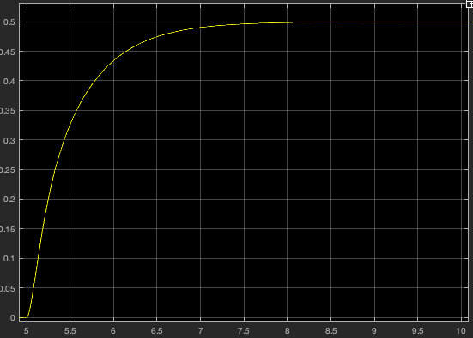
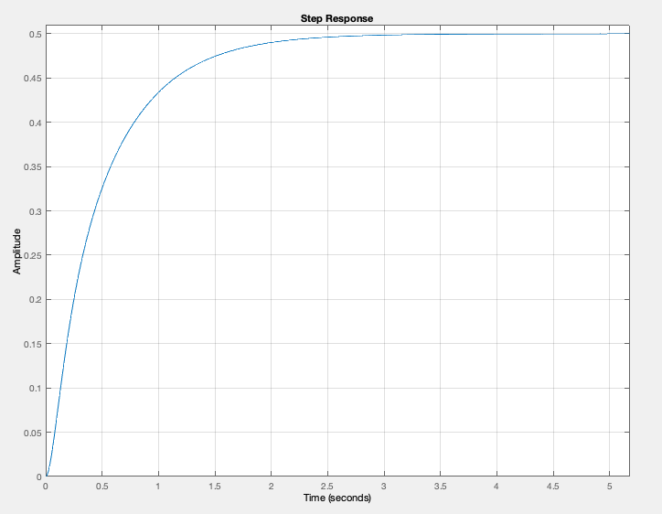
Velocity Command Step Input
Compares Simulink “linearized” block (left) with LTI Transfer Function (right)
Note this is for stability margin calculation. Simulink non-linear elements turned on for budget analysis.

Slide 17
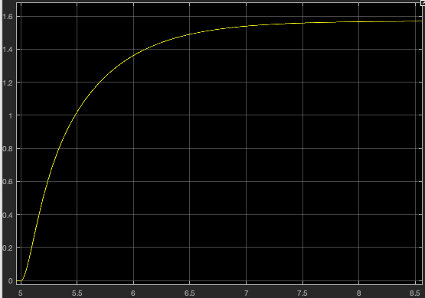
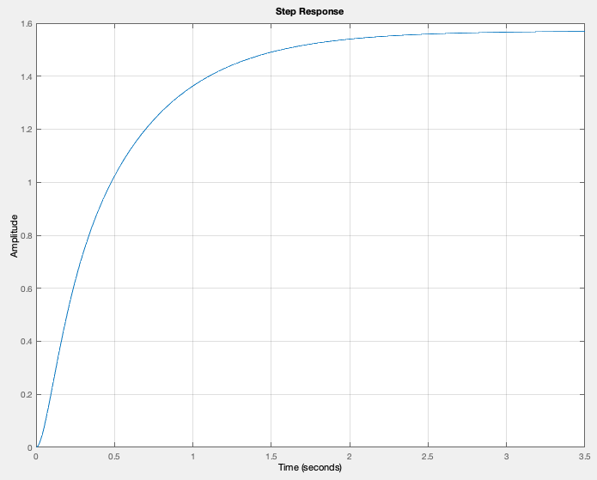
Position Command Step Input
Compares Simulink “linearized” block (left) with LTI Transfer Function (right)
Note this is for stability margin calculation. Simulink non-linear elements turned on for budget analysis.

Slide 18
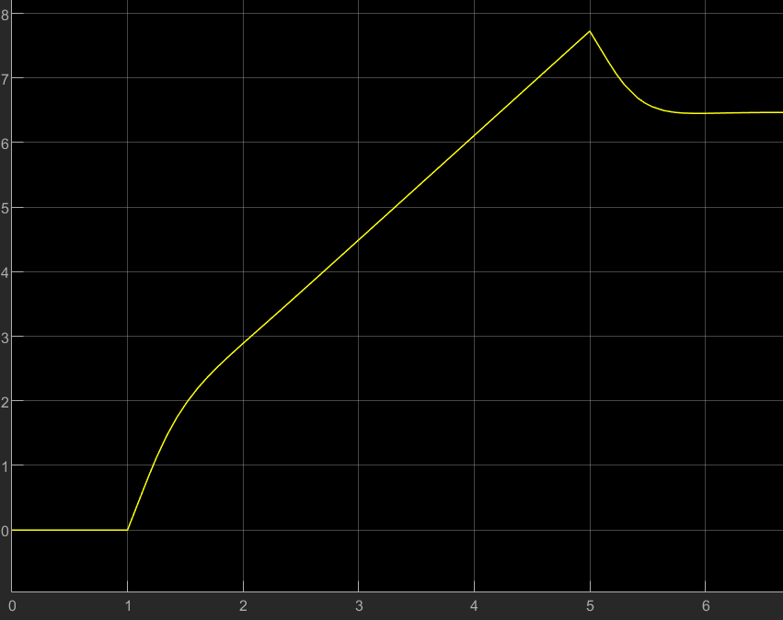

RGA-OS Insertion
In order to determine the peak force or moment experienced by the kinematic control frame (kcf) during an active compliance insertion, we need two components:
The steady state “compliant” response that corresponds to an RCCM deflecting sideways
The transient “damping” response that represents the stabilizing terms of the control system slowing down the response
Summing these values gives us the peak magnitude.
Steady state magnitude is just $F=k_{active} x_{misalign}$
Transient lag is the steady state response to a step velocity input to the force control system.
Response to chamfer translation ramp
Lag caused by stabilizing damping term
Force (N)
Equivalent “idealized”
passive stiffness response
Time (secs)

Slide 19
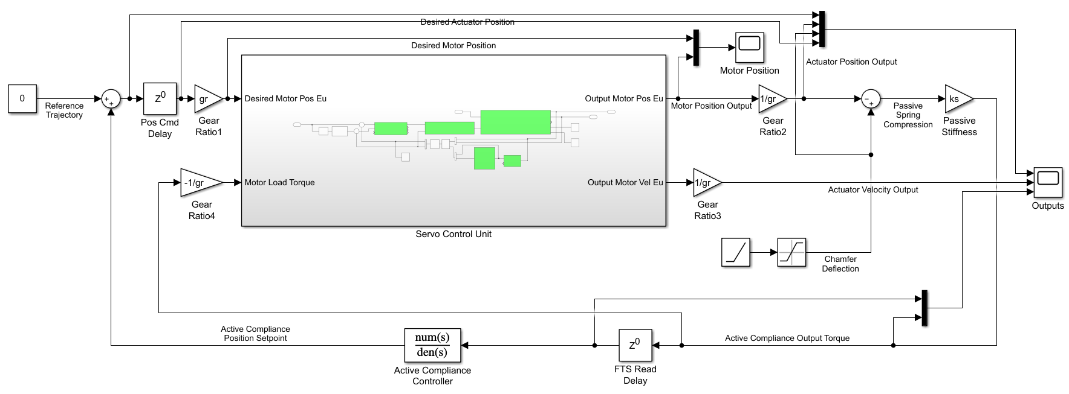
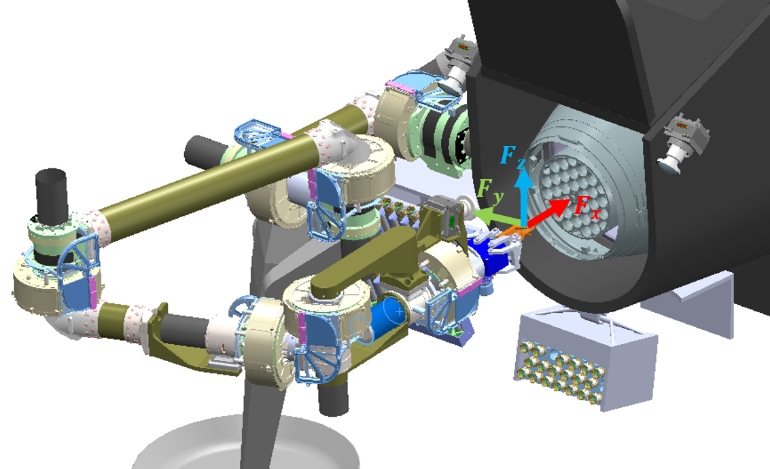
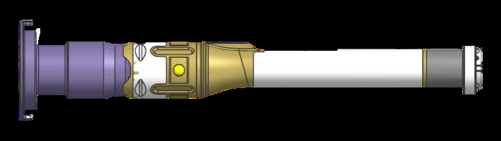


Active Compliance – Tolerable Control Rate
Goal: determine the rate and latency (RTIs) that an active compliance system could permit and remain stable with flight-like arm dynamics.
Early analyses extended the JPLCAMS Simulink library from the SCS SHACD modelling efforts into the active compliance domain.
Actuator dynamics are taken from ESA/LDO proposed motors and gearboxes, with JPLCAMS PID tuning applied to “SCU” joint position controller. (given no LDO joint control parameters supplied as of yet)
The full 6-DoF active compliance problem is abstracted down to a single-DoF representation looking at joint 6 complying in translation along the Y axis of tool frame to examine impacts of rate and latency on closed loop response.
PDR MODEL
SCU
JPLCAMS Simulink Model of Single-DoF Active Compliance
Full OS insertion configuration
Joint 6 -> EE radius
Insertion velocity
Single-DoF abstraction of active compliance control law
Insertion axis
Joint 6
$$k_{mech}$$
$$θ, τ$$
Deflection axis (tool frame Y axis)
Deflection response
Joint 6 -> EE radius
OS Chamfer

Slide 20
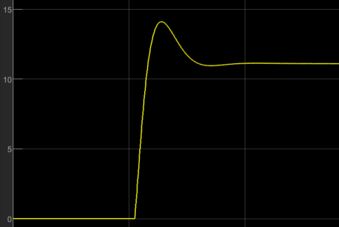
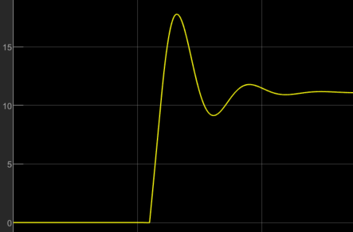
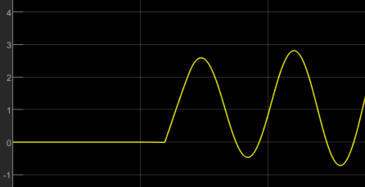

Simulink Results
Controlled parameters:
Joint command & FTS read RATE – The frequency at which joint position commands are sent, and FTS measurements are read; emulating the speed of an LMC->SCU comms interface
Joint command & FTS read LATENCY – The number of cycles at the given rate that both the outgoing joint command signals and incoming FTS measurements are delayed; emulating RTIs
“Stability” here is considered as $ζ>0.5$ where there are $<2$ negative peaks
Conclusion:
Only 256Hz is stable through 5 RTI of command and read latency, however, 128Hz may be sufficient for $≤3$ RTI command & sense latency (6 RTI total)
PDR TABLE
Stable
Round Trip | 16 Hz | 32 Hz | 64 Hz | 128 Hz | 256 Hz
2 RTI | Unstable | Marginal | Stable | Stable | Stable
4 RTI | Unstable | Unstable | Marginal | Stable | Stable
6 RTI | Unstable | Unstable | Marginal | Stable | Stable
8 RTI | Unstable | Unstable | Marginal | Marginal | Stable
10 RTI | Unstable | Unstable | Unstable | Marginal | Stable
Marginal
Unstable

Slide 21
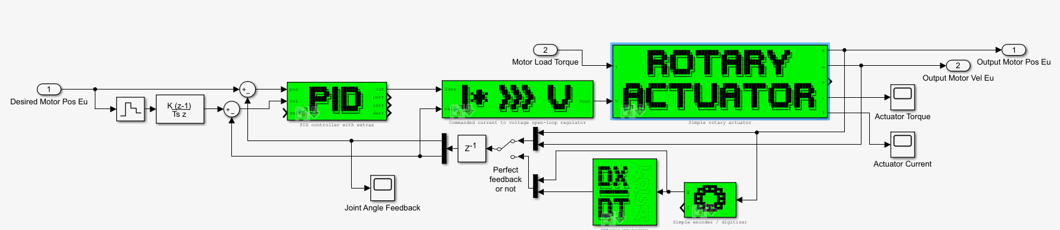
BACKUP – Simulink Model
PDR MODEL
SCU
Servo Control Unit

